Slide 1

Capstone Project
Hotel Booking Analysis Team Member Sanjay Singh Rawat

Slide 2
Points Of Discussion
Agenda
Data Summary
Data Wrangling
Hotel Wise Analysis
Booking Cancellation Analysis
Booking Analysis For The Hotels Yearly Wise
Analysis Of Market Segments & Distribution Channels
ADR Value Analysis
Correlation Analysis With Heatmap
Conclusion

Slide 3
Agenda
To discuss the analysis for given hotel bookings data for year 2015-2017. We will perform the analysis for given data set in the following manner
Hotel wise analysis
Univariate Analysis
Market segment and distribution channel analysis
Booking cancellation ratio analysis
Time wise analysis
Correlation analysis

Slide 4
Data Summary
Given data set has different columns of variables that are important for hotel bookings analysis in order to get some insights from raw data.
Hotel: Contains the category of hotels i.e city hotels and resort hotels
is_cancelled: This column holds data that shows either the hotel is cancelled or not.
stayed_in_weekday_nights: Holds the data that shows stay count for weekday nights.
stayed_in_weekend_nights: Holds the data that shows stay count for weekend nights.
meal: Holds the data for type of meal provided by hotels.
country: Holds the data for different countries where from bookings were made.
market_segment: Holds data for how the bookings were made and the purpose of bookings.

Slide 5
Data Summary
distribution_channel: Shows medium through which bookings were made.
is_repeated_guest: Holds data in format of 0 & 1 where 1 indicates that the guest is repeated guest 0 vice versa.
country: Shows the origin of guest or from which country guest belongs to.

Slide 6
Data Wrangling
Data wrangling performed over the provided data set as there were many columns that holds the Null values.
Data were transformed from raw data to meaningful data.
Some meaningful information about data was generated using different methods.

Slide 7
Hotel-wise Analysis
Large data set was divided into two smaller data sets named city hotel & resort hotel where following points were discussed
Percentage of bookings in per hotel.
Which hotel makes more revenue.
Preferred stay length for each hotel.
Which hotels suites for type or group of guests.
Which hotel has the highest cancellation ratio.

Slide 8
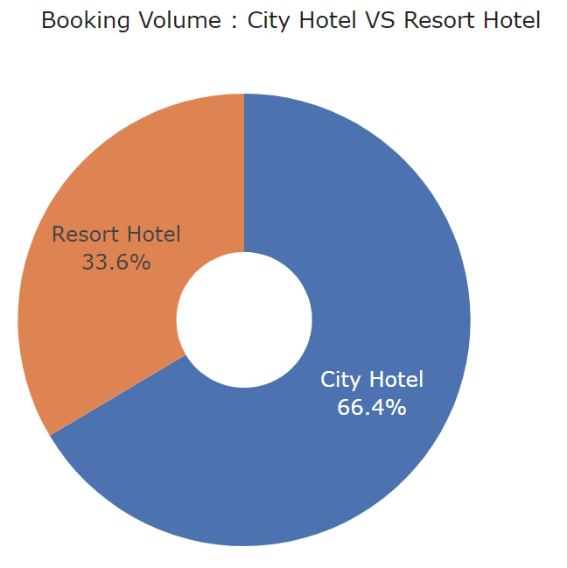
Hotel-wise Analysis
This image clearly shows the ratio of bookings in between two different type of hotels.
From here we can answer or conclude many of the important insights about data like -
Which type of hotels makes more revenue.
Which type of hotel is more preferred over another hotel and many more.
Out of 100% , 66.4 almost double booking were made for city hotels than the resort hotels.

Slide 9
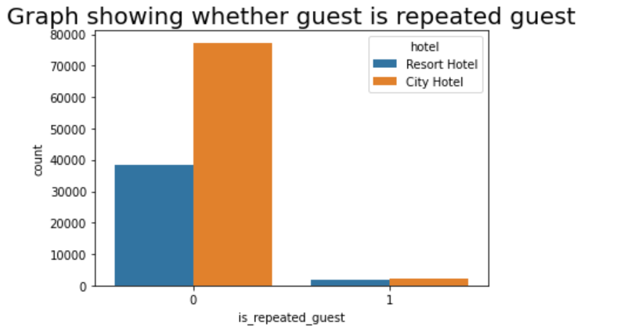
Hotel-wise Analysis(cont…)
This graph shows whether the bookings were made by repeated guests or new guests for city and resort hotels.
From the graph we are seeing that the mostly bookings are generated from the new guests and lower the count of repeated guests.
Hotels can focus to get the repeated guests as they made the bookings before.
Hotels can find out the cause for lower number of repeated guests and increase their revenue.

Slide 10
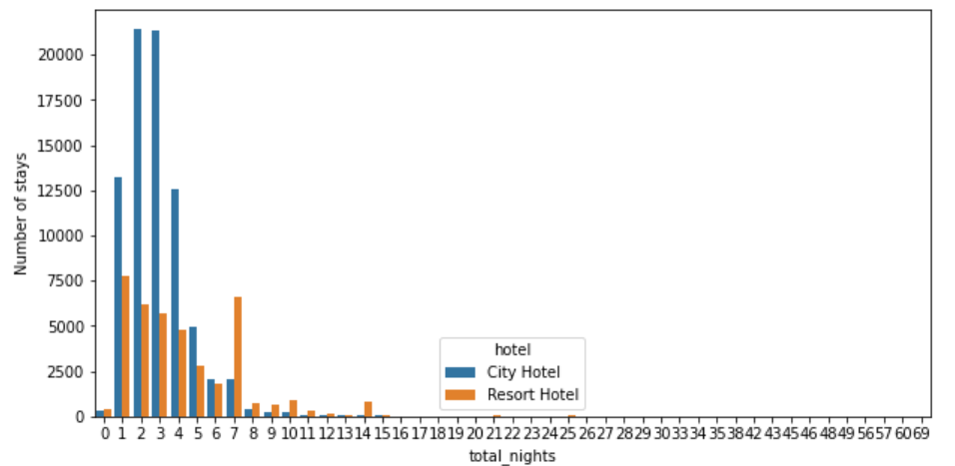
Maximum stay made by guests is between 1-5 days.
Number of stays show the number of guests stays and total nights is the count of the night stay made by guests.
Image shows stats for city hotel and resort hotel

Slide 11
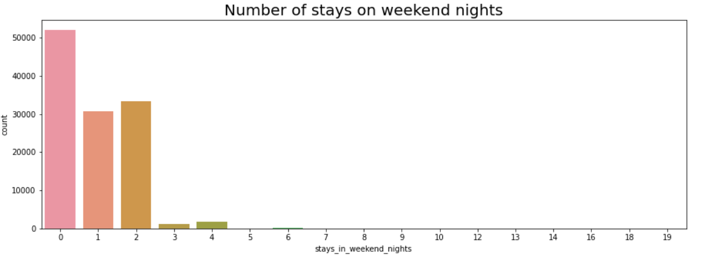
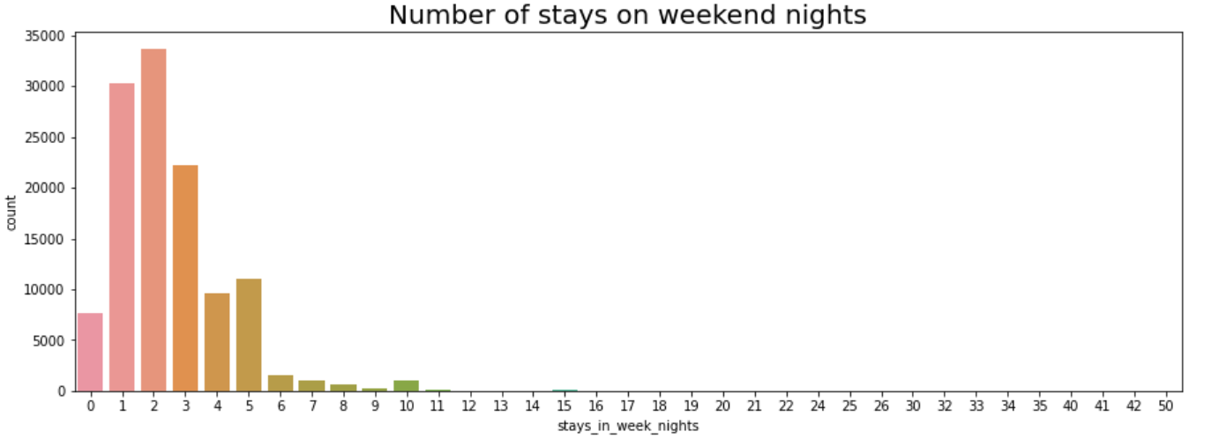
Univariate Analysis
The first graph generates the number of stay made by guest on weekend nights.
Here count represents the number of guests that made such bookings & stays_in_weekend_nights represents the number of nights.
Similarly the data om x and y axis graph two represents the respective data.
From here by analyzing the two graphs we can conclude that stays for week nights is higher than stays made for weekend nights

Slide 12
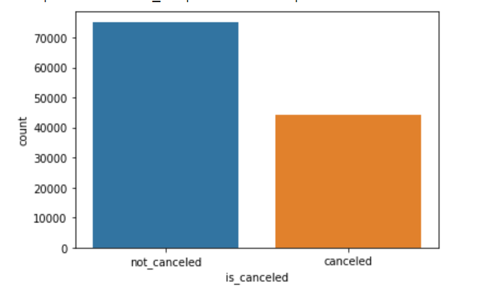
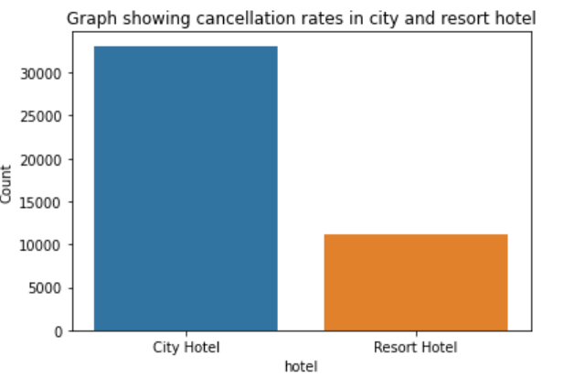
Booking Cancellation Analysis
Graph 1 shows ratio of booking cancelled and not cancelled.
Here we can clearly see the difference between two this is the major drawback for low revenue of the hotels as so many bookings were cancelled due to some reasons.
Second graph is similar to the first one but this graph represents the booking cancellation ratio difference between the category of hotels i.e City Hotel and Resort Hotels.
Here we can conclude by seeing the image that the maximum number of bookings were cancelled for City Hotel than the Resort hotel

Slide 13
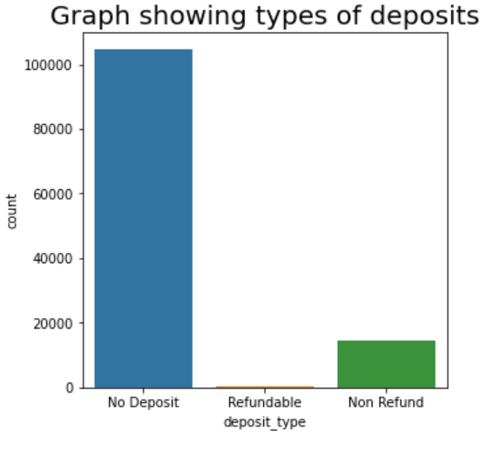
Booking Cancellation Analysis(cont…)
Graph show the type of deposits used to make the hotel bookings.
Majority of the booking does not require deposit. Thatcould explain why cancellation rate is so high as compare to non-cancellation rate.
No deposit before bookings may be one the reason for high ratio of booking cancelled.

Slide 14
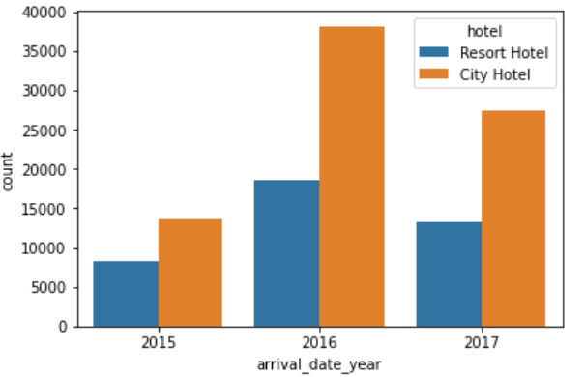
Booking Analysis For The Hotels Yearly Wise
Here comparison made between city and resort hotel yearly basis from the image we can clearly state the difference for each year’s bookings where city hotel is the winner over resort hotel for each year.
Here count show the numbers of booking and arrival_date_year represents different years,
Count show the counts of booking made for each year (2015,2016 & 2017) respectively.

Slide 15
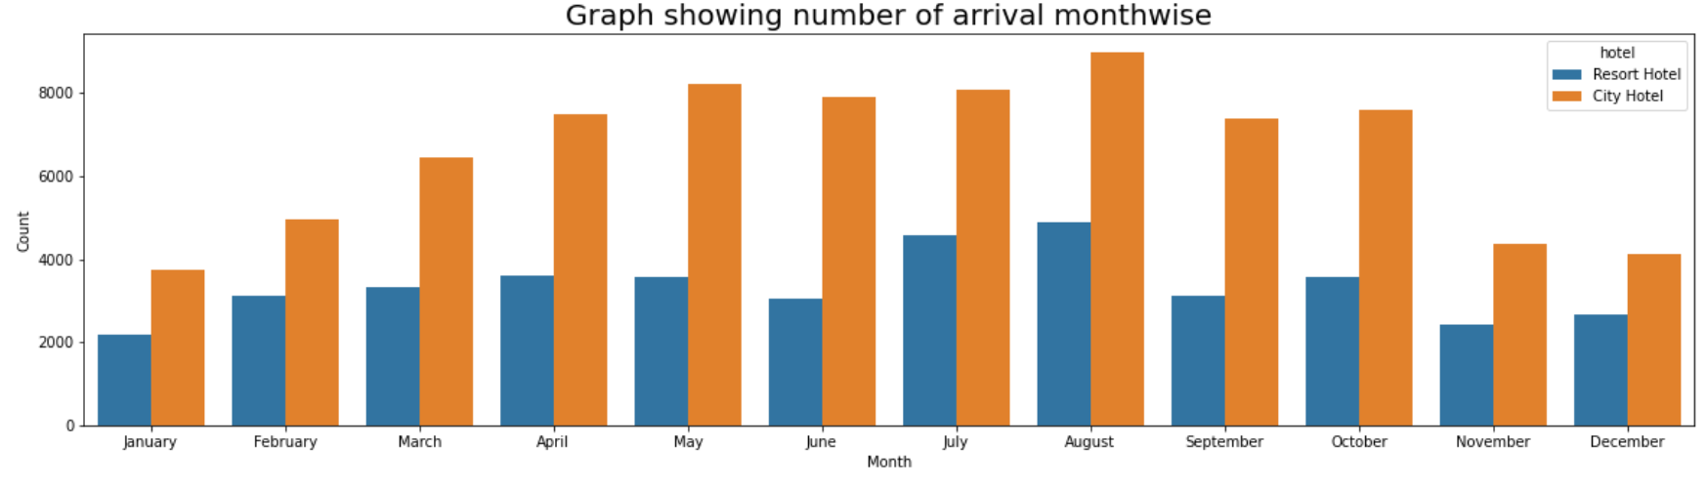
Booking Analysis For The Hotels Month-Wise
Above graph is the representation of the bookings for City and resort hotels month-wise.
We can state by seeing the above graph that the months July & August makes high revenue for the both hotels as it is summer time , we can say that people used to spend outdoor vacation in this time period.
Hotels can provide some kind of offer for this time period in order to generate higher revenue.

Slide 16
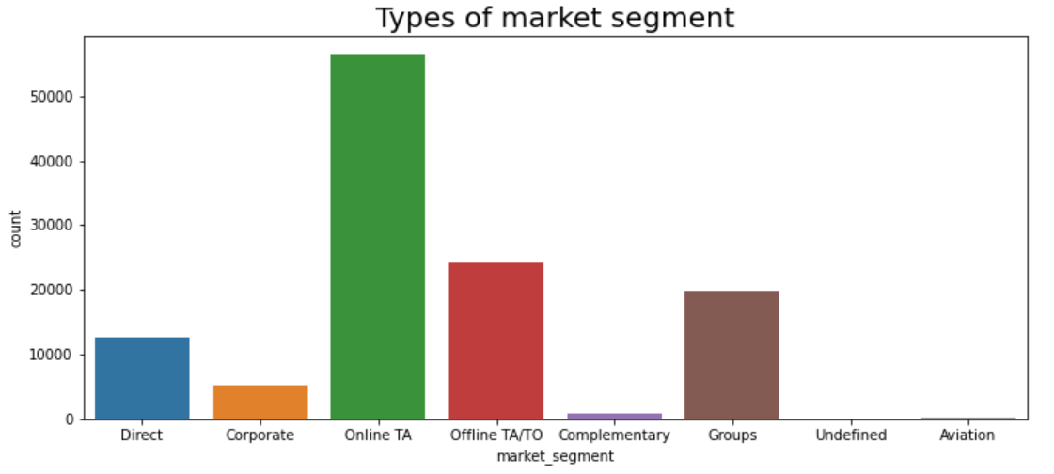
Analysis Of Market Segments
Most of the bookings come via online TA. City Hotel can work to increase outreach on offline TA/TO channels as well as Direct channels to get more higher revenue generating deals.

Slide 17
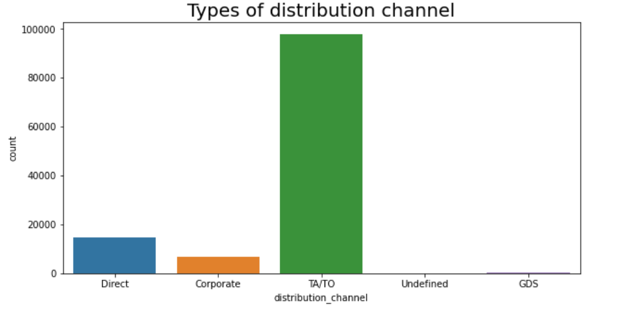
Analysis Of Distribution Channels
Graph shows some of the most important distribution channels that plays an important role in hotel bookings.
Majority of the distribution channels and market segments involve travel agencies (online or offline). We can target our marketing area to be on these travel agencies website and work with them since majority of the visitors tend to reach out to them.

Slide 18
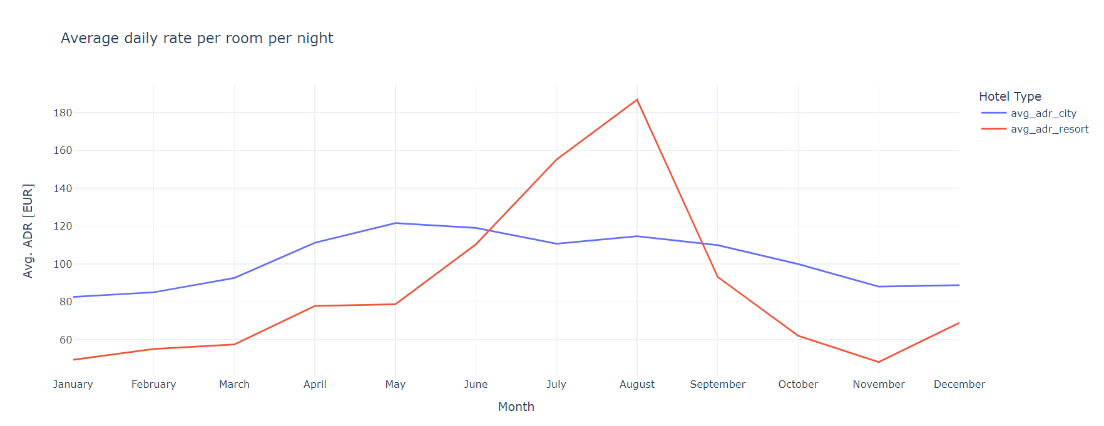
ADR value Analysis
Above graph shows the ADR (Average daily rate) value for city as well as resort hotels for each months together.
ADR value graph is plotted for city and resort hotels on the basis of per night for each month.
ADR fluctuates for resort hotels while ADR for city hotel is quite straight.

Slide 19
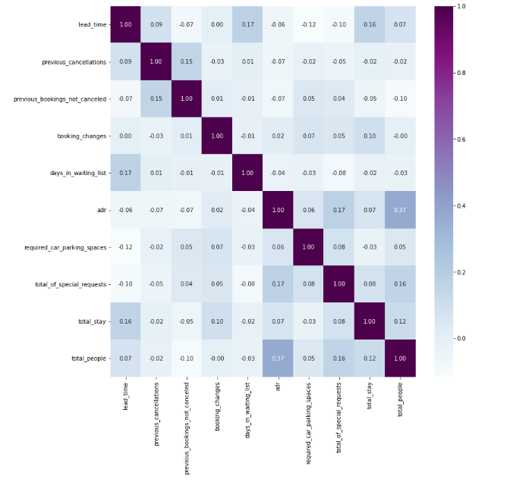
Correlation With Heat-map
We can see that lead time and length of stay have a good correlation with each other. Thus we may conclude that generally visits planned with longer stays are booked earlier than those planned with shorter stay. ADR and total number of guests also have good correlation with each other. This may be because of the increase in expenditure with the increase in the count of guests

Slide 20
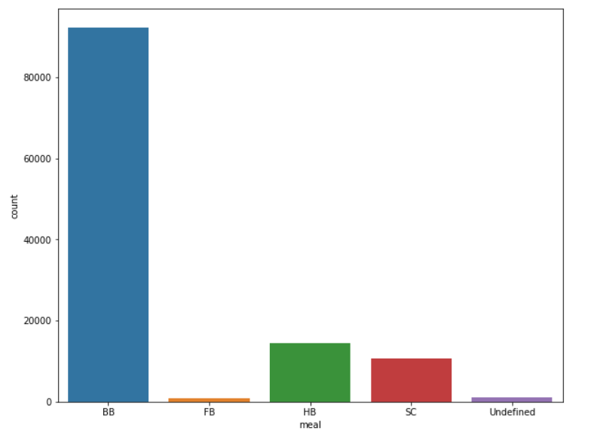
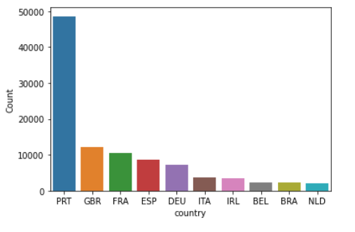
Some Other Points
Graph shows the most preferred type of meal in the hotels.
By seeing the graph we can state that the most preferred type of meal by the guest in hotels is BB or Bed Breakfast.
The second graph generated the output for the bookings made by different countries.
And we can see most of the bookings comes from PRT or Portugal country.

Slide 21
Conclusion
City Hotels gets more bookings over Resort Hotel or more preferred while Resort Hotels are preferred for larger groups or families.
Found that booking cancellation rate was higher than bookings get confirmed also cancellation of bookings rate is higher for City Hotels as compare to Resort Hotels.
Found that year 2016 is the winner in matter of bookings as compared to other years for City as well as Resort Hotels.
Months May,June,July and August gets highest numbers of booking as compared to other months mean high revenue in these months.
Here we conclude that stays for week nights is higher over stays weekend nights.

Slide 22
Conclusion(cont…)
Majority of the distribution channels and market segments involve travel agencies (online or offline). We can target our marketing area to be on these travel agencies website and work with them since majority of the visitors tend to reach out to them.
Majority of the booking does not require deposit that may be one of the many reason for cancellation of bookings.
Found that the low number of repeated guests.
ADR (Average Daily Rate) fluctuates for resort hotels while ADR for city hotel is quite straight.
People prefers to stay for max 5 days in a hotel and from country portugal has the most number of bookings.
We can see that lead time and length of stay have a good correlation with each other. Thus we may conclude that generally visits planned with longer stays are booked earlier than those planned with shorter stay

